Slide 1

Module Code: SOFT40161 Module Name: Introduction to Computer Programming Lecture 02: Procedural Programming: Control Structures with Python (Week 11:02)
M. Arifur Rahman, PhD
Department of Computer Science, NTU
Arif.Rahman@ntu.ac.uk

Slide 2
Module Contents and Our Plan!
Lecture | Week | Topic | Comment
Lecture 01 | Week 11 | Module Introduction, Programming Basics: Python Environment, Installation, Variables, Data Types and Operations
Lecture 02 | Week 12 | Procedural Programming: Control Structures with Python (Sequence, Branching, Conditions and Looping) | This Week!
Lecture 03 | Week 13 | Data Structures Concepts in Python (Lists, Tuples, Sets and Dictionaries) and Code Quality Considerations
Lecture 04 | Week 14 | Functions, Modules, Argument Passing, Recursion and Exceptions
Lecture 05 | Week 15 | Concepts of Object-Oriented Programming (Classes, Methods, and Constructors)
Lecture 06 | Week 16 | Working with Data: File I/O and Data Handling and NumPy Operations
Lecture 07 | Week 17 | Data Manipulation with Pandas and Python Libraries
Lecture 08 | Week 18 | Data Visualization: Basic to Customisation
Lecture 09 | Week 19 | Working with Real-World Data, Python for Machine Learning
Lecture 10 | Week 20 | GUI with Python, Coursework, Projects and Review

Slide 3
Learning Outcomes (LO) of this module:
Remembering: Define sequence, branching, conditions, and loops.
Understanding: Explain the role of control structures in Python.
Applying: Use control structures to solve procedural problems.
Analyzing: Differentiate between types of loops and conditions.
Evaluating: Assess code efficiency and structure with control statements.
Creating: Design Python programs using control structures effectively.

Slide 4
Roadmap
Structure and syntax
Program flow
Variables and types
Branching
Conditions
Iteration

Slide 5
Programming languages - A summary
There are a number of high-level languages available.
The ones that you will be using in your degree are Python, C++, Java / JavaScript and C#.
Programming languages are used to express a set of instructions which enable you to complete a task.
They have SYNTAX (set of rules for grammar and spelling) and STRUCTURE
Provide ways to DECLARE things and DO things
Even though programming languages have different / or similar syntaxes, the underlying programming concepts are the same.
For example, understanding how an if statement works will allow you to apply that knowledge to each language.

Slide 6
Programming languages - A summary
Most languages (e.g. C, C++, Java) use a compiler to “compile” code that you understand into something that the processor can understand.
Source Text
Compiler
Executable Code
IC
Source code
Program text input
IC Optimisation
IC
Executable file
Intermediate Code Generation
Intermediate Code
Executable Code output
characters
IC
Lexical analysis
Code Generation
Annotated AST
Bit patterns
tokens
Context Handling
Symbolic instructions
Machine Code Generation
Syntax Analysis
Target Code Optimization
Abstract syntax tree
AST
Symbolic instructions
Front-end
Back-end

Slide 7
Programming languages - Python
Actually, Python isn’t a compiler!
Remember from last time, Python is an interpreter.
The front-end modules found within an interpreter are the same as those found in a compiler.
However, the back-end modules are different. These now interpret the intermediate code, rather than generate machine code.
Source code
Program text input
Interpretation
characters
Lexical analysis
Annotated AST
tokens
Context Handling
Syntax Analysis
AST
Front-end
Back-end

Slide 8
Programming languages - Syntax
When we speak a language, we have to follow rules for sentence construction.
The same applies to computer languages.
Computer languages have to follow a syntax to correctly represent instructions. This is also known as the language grammar.
Subjects
Verbs
Pronouns
Adjectives
Adverbs
etc!
if statement
Syntax tree
if
condition
then
statement
For the full python language grammar visit: https://docs.python.org/3/reference/grammar.html

Slide 9
Program Flow
A CPU core has a thread of execution.
Instructions are fed to the processor and then executed.
Programs could have multiple paths of flow when executing.
name = input('Enter your name:');
repeat = int(input('Enter the number of times to repeat:'));
if( repeat not in range(5, 10) ):
print(‘An invalid value has been entered!’);
else:
for x in range(repeat):
print(name);

Slide 10
Basic Variables - a reminder
The purpose of a variable is to store some information.
There are a number of basic variable types in Python:
Integers
For example: x = 10
Integers are signed (i.e. can be + or -).
They also can only store whole numbers. E.g. 10.5 would not be a integer, but a float.
Integers can have different operators applied to them. E.g. ( *, /, -, +) as well as being used with relational operators (see later).
In Python, integers are 2³² bits in size but beyond that, they turn into python long variables.
In other languages, integers usually have a fixed length and will not automatically change to another type (e.g. C++, C#, Java).
Long
For example: x = 288347284887584788484883909348753453453453
Long values are not limited to 2³² but on how much memory is available.
This is different to how other languages handle longs as they depend on a fixed length.
Assignment operator

Slide 11
Basic Variables - a reminder
The purpose of a variable is to store some information.
There are a number of basic variable types in Python:
Floats
X = 10.5
Floats are similar to int / long but can store whole and partial numbers.
E.g. 345565.2347333
Strings
name = ‘Clark Kent’
Other basic variable types:
List
Tuples
Dictionaries
We will look at these in another lecture

Slide 12
Variables (from a memory POV)
Python hides how variables are stored (i.e. are they stored on the stack or heap?) and how they are accessed.
In reality, memory will be allocated to store each data type.
Enough memory would be allocated to store the entire number (e.g. 2³² bits for an integer)
A = 5
But, in python, when a value is re-assigned, a new memory object is used (it is immutable)
5
2³² bits allocated to store value
6
6
b = 5.5
A
b
Max number of bits allocated to store value
A = 6
5.5

Slide 13
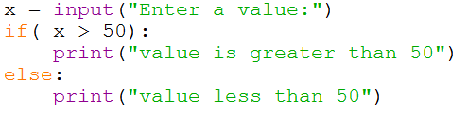
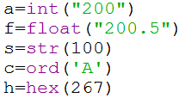
Converting between types
You can overwrite the value stored in a variable with a different form of information…
You need to be careful when comparing values…
Would cause an error…
This is because x is storing the number as a string and we want to manipulate it as if it is an integer
We need to convert values…
returns the number representing the unicode code of a specified character
convert an integer number into it's corresponding hexadecimal

Slide 14
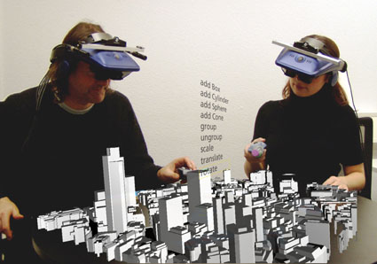
Augmented Assignment Operators
Lazy programmers never write two things if they can write one
The Assignment Operator gives a value to a variable
An AUGMENTED assignment operator does something with it first
X += 5 is same as X = X+5
i.e. take the value referred to by X, add 5 to it, then save it back in the variable X
Saves typing a whole extra character!

Slide 15
Branching – if statements
There are times when a decision needs to occur within your program which will alter its behaviour and program flow.
The if statement allows a decision to be made:
Program flow:
Is condition true?
No
if( condition ):
# code block A
print(“message1”)
else:
# code block B
print(“message2”)
Yes
message1
message2
Do something
end

Slide 16
Equivalence
We have seen that setting a value can be performed by using the = (assignment) operator.
How would you check to see if the value contained within the variable is equal to a certain value?
Use the equivalence operator ==
E.g.
Setting, a = 5
if( a==5 ) -> True
if( a==6 ) -> False
Equivalence will return a TRUE or FALSE value.
i.e. is the data on the left the same as the data on the right
Need to be careful with assignments…
if( a=5 ) -> would result in TRUE (as the assignment succeeds)

Slide 17
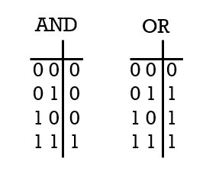
Evaluating Conditions
When evaluating conditions they need to evaluate to a TRUE or FALSE value.
E.g.
if( 5==5 ):
We can also have more complex conditions.
You can use logical AND / OR (and also NOT):
TRUE
Relational operators:
> (greater than)
< (less than)
>= (greater than or equal to)
<= (less than or equal to)
== (the same i.e. equal)
!= (not equal)
Say,
A = 5
B = 6
C = 7
D=True
( (A==5) and (B>C) )
?
False
(((C>A) and (C>B)) or (A==5))
?
True
?
True
((A == 5 ) and (C > B))
(not D)?
False

Slide 18
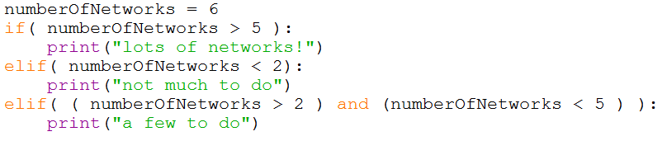
Multiple if’s
We can daisy chain an if statement together to provide a multiple-path choice.
Can use the if / elif or if / elif / else construct.
>5
<2
Could replace this with an else clause instead (it would provide the same behaviour)
>2 and <5

Slide 19
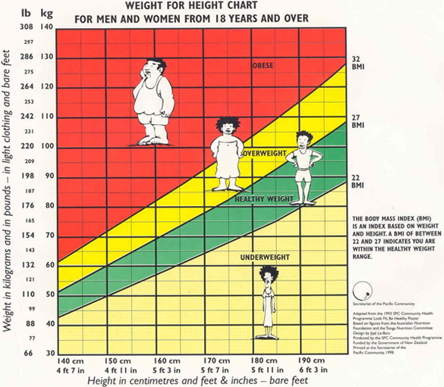
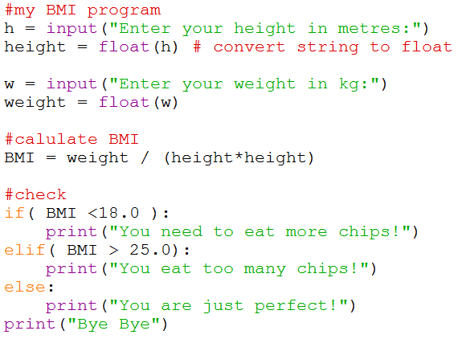



Example of Using multiple if’s - BMI

Slide 20
Ternary Statement
Python has another way for decision making that is precise and the code will be more beautiful.
temperature = 25
if temperature >= 30 :
message = "its warm“
print(message)
else :
message = "melo"
print(message)
print("Bye")
Ternary operator
The whole code, in front can be written like Below.
message = "its warm" if temperature > 20 else "melo"

Slide 21
Short circuit operators
When you use and operator, If the first expression is False the whole execution will be false and the execution stops, this is called short-circuit.
In this if statement a is False so the whole expression is False now.
a = False
b = True
c = True
if a and b and not c:
print("yes")

Slide 22
Chaining operators
For example : you need to see if the number is between 20 and 30
You can do it with two and operator or you can chain two operators.
x = 25
# normal
if x > 20 and x < 30:
print("accepted")
# Chaining
if 20 < x < 30:
print("accepted")

Slide 23
Iteration
There are times when we need to do the same instructions multiple times:
name=input(“Enter your name”)
# display 5 times
print(name)
print(name)
print(name)
print(name)
print(name)
Entername
It would be good if a loop could be used so that we only have to write the code once.
It is bad to repeat the same thing.
What would happen if we needed to repeat 8 times instead?
Code would have to be changed.
Repeated 5 times?
No
Print name
Question: Is this a good way to program?
Yes
end

Slide 24
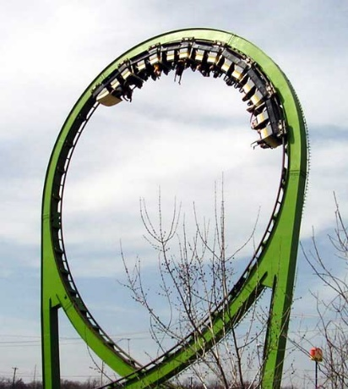


Iteration – while loops
We use a LOOP – there are WHILE loops and FOR loops
While loops allow you to repeat until some condition is met hopefully at some point in the future.
Syntax:
while (<condition>):
<code block>
Examples:
Everything in the indented block after while is executed while the condition evaluates to True
If the condition happens to be False at the start, then the code in the block is never executed
NOTE that evaluation of conditions assumes that if a quantity evaluates to non-zero, then it counts as True, whereas a zero counts as False

Slide 25
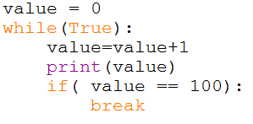
Infinite loops
Sometimes we want a loop that continues forever UNLESS something happens in the loop body to allow it to exit
We use the reserved keyword break to get out
There are other scenarios where we want to loop forever…

Slide 26
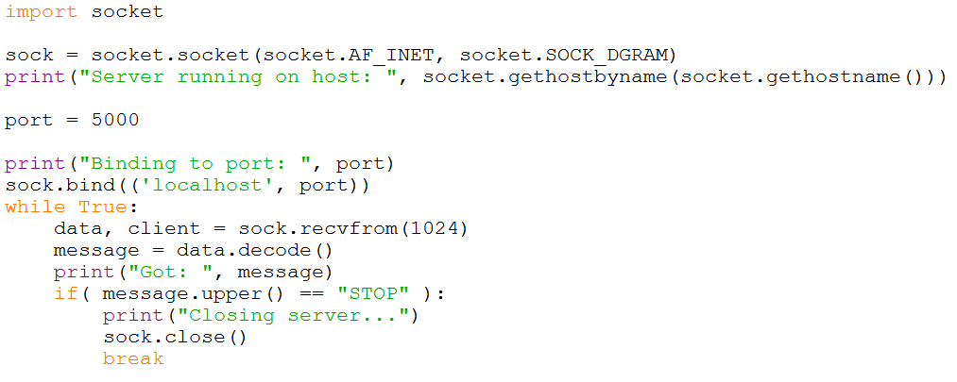
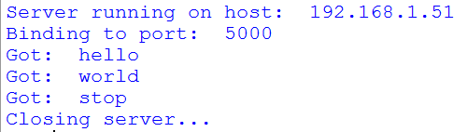
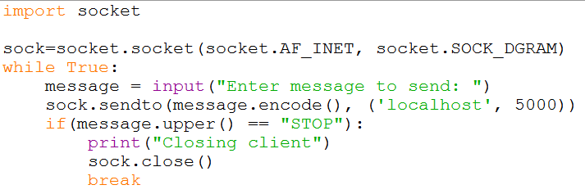
Advanced uses of while loops
Writing a network server…
The client…

Slide 27
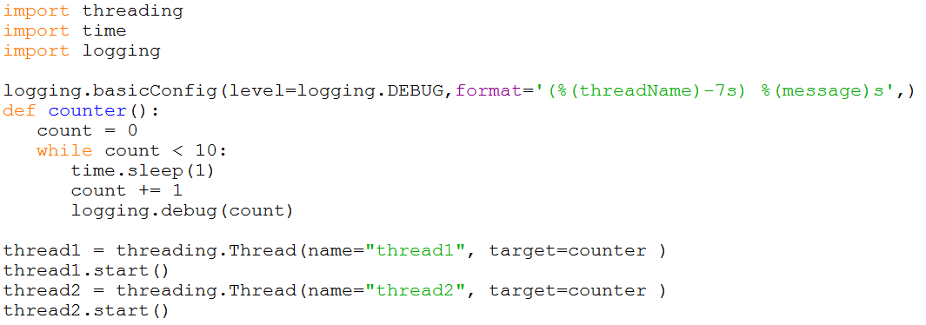
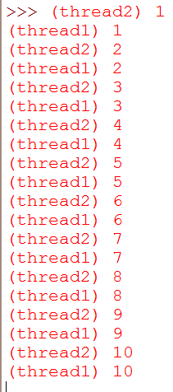
Advanced uses of while loops
Multi-tasking

Slide 28



Iteration – For loops
For loops allow you to repeat a known number of times (i.e. you know in advance how many times to repeat).
Syntax:
for <variable> in <max value>:
Can use range for 1..max value
Examples:
condition

Slide 29
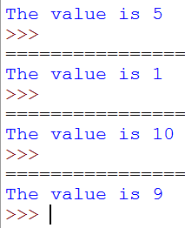

Random numbers
http://www.codinghorror.com/blog/2006/11/computers-are-lousy-random-number-generators.html
In programs we need random numbers for a lot of purposes
Not REALLY random
There is a library that provides this – so we have to IMPORT it (make it available to our program)
We then use a function that is part of that module in our program

Slide 30
Directed study / tasks
Be careful to understand the difference between if and while
If is a choice and the chosen section of code is executed once
While is a repeating structure, and the section of code is repeated until the condition becomes false
Remember your paper and pencil – in particular, use them to work through the values of variables and decide which branch of the ‘if’ is executed, and what the values are as you cycle round the ‘while’ loop
1. Practice writing more complex programs which use if statements, while loops and/or for loops.
2. look through chapters 3 & 4 from book.
Advanced Tasks (optional)
1. investigate socket programming
2. investigate multi-tasking

Slide 31
